Slide 1
Mobile Network
rtbdemand.com
Notes:
‹#›
g

Slide 2
Driving global mobile App Distribution
Targeted Users Apps Distribution 31K
Machine Learning Mobile Publisher 410+
Global Ecosystem Top Publisher Earning 130K
Variety of Formats App Downloads 1.7MM
High Value users

Slide 3
Different types of Traffic
Media Buying buying via DSP via direct deals,PMP
Self Service SDK Platforms like Chartboost,Vungle,Appnext,UnityAd etc
Direct API integrations with Publishers via API

Slide 4
Quality Highlights
Automated
Control of quality for CR rates
Control of quality for duplicate ips,bad referral etc
Using tools like 24 metrics etc
Lot of the above is automated to block subids
Manual
Advertiser can block subids with bad quality in terms of CR/Conversion rates etc

Slide 5
Advertiser Advantages
Brand safety with automated quality tools
Quality control via install and post install postbacks
Leading Tracking providers integrated
Self Service tool/Managed and API integrations with Advertisers
S2S integration with Advertisers
Tracking of performance at subid levels
Ability to pass GAID,IDFA etc for most traffic
Automatic Fraud control basis high CTR and other parameters like Adult etc
You get volumes you are looking for

Slide 6
Case Study1
Uber
● To drive installs
● To drive bookings
● MTTI or Median Time to Installs to avoid click spam
● Targeting :Pan India
● Exclude Traffic:No incent,No adult,No bot
● Sign up conversion rate and install to signup conversion rates to be maintainedt

Slide 7
Our Approach
To drive installs/booking
● We placed postback to track install and second postback to track post install actions like Registrations and bookings with amount
● We optimized traffic source for these metrics
For fraud control
● We use 24metrics to look at MTTI,any blacklisted subids,bot etc.The way this managed is we capture the ip,session time and install time in the postback.This helps us to identify fraud patterns of all sorts
● Duplicate ips
● Click spams by measuring difference between time installed and click time
● Blacklisted subids

Slide 8
End Results
● We brought more 100K installs in a month and met KPI goals with bookings and signup to expectation
● We also had fraud % less than 5% due to same
● We applied both manual and automatic rules to block traffic sources which did not work for us

Slide 9
Case Study2
Myntra
● KPI:day 2 retention-30%
● In App purchase 15-20% over 30 days
● No Incent traffic
● Targeting WIFI only

Slide 10
Myntra
For KPI goals
Again we place secondary postback and install postback to manage KPI goals
For targeting
We use our exchange traffic and targeted only WIFI users
For no Incent traffic
We monitored CR rates for traffic sources to block traffic sources with high CR and also used 24metrics to block traffic sources with historical data for incent

Slide 11
Results
We met the goals and reached 150K installs in 60 day period and met the business goals of 10% of purchases over 30 days for 90% of the installs.

Slide 12
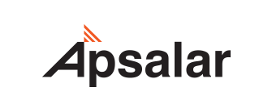
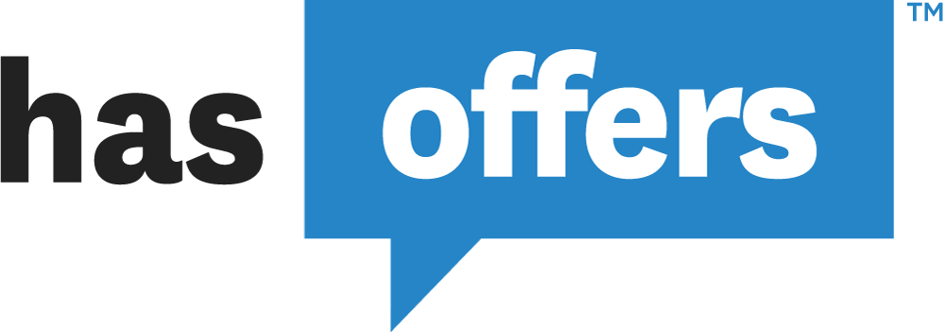
Tracking Tool Support

Slide 13
Our Network
Top Apps
Top Platforms

Slide 14
Thank you
Will be happy to be demonstrate-to Advertisers
How to get more installs
Increasing reach
Get High Value users
Tracking post events

